Slide 1
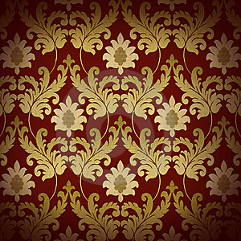
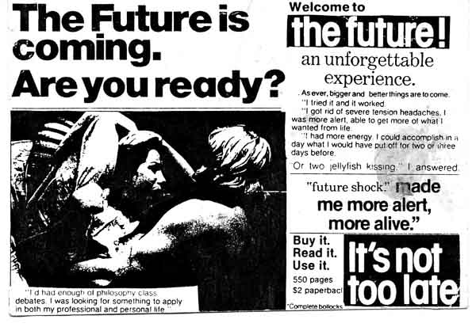
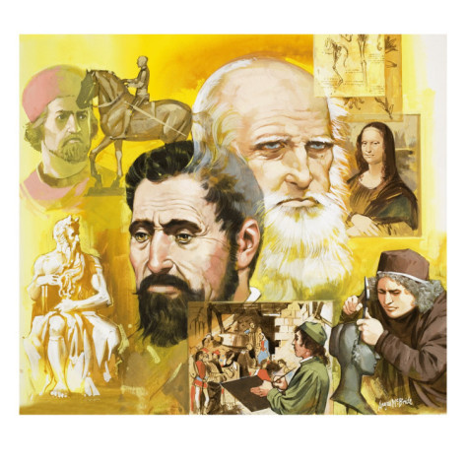
The Crusades, the Black Death and the 100 Years’ War all brought about an end to the Middle Ages….
A period of “re-birth” began- changes were RAPID
The RENAISSANCE
The Reformation
The Scientific Revolution
Age of Discovery & Conquest
Change is good, but it is also frightening to many people

Slide 2
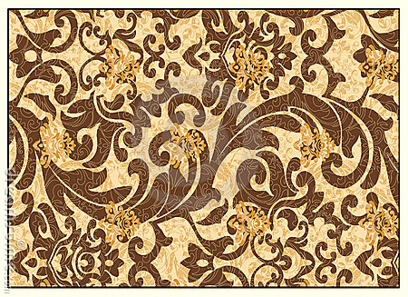
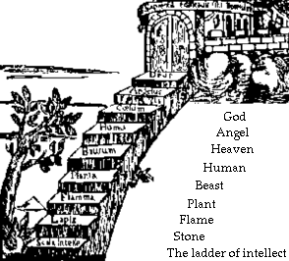
Breakdown of the Medieval Social Order
Great Chain of Being
God..Angels…Clergy…then
Kings
Nobles and Knights
Merchants and Artisans
Peasants and Serfs
People were used to having a specific place in society - at least they knew what to expect…… we will learn about the great things that happened because of the Renaissance and some of the bad things that happened because people reacted badly to change & could not accept new ideas or ways of living.

Slide 3
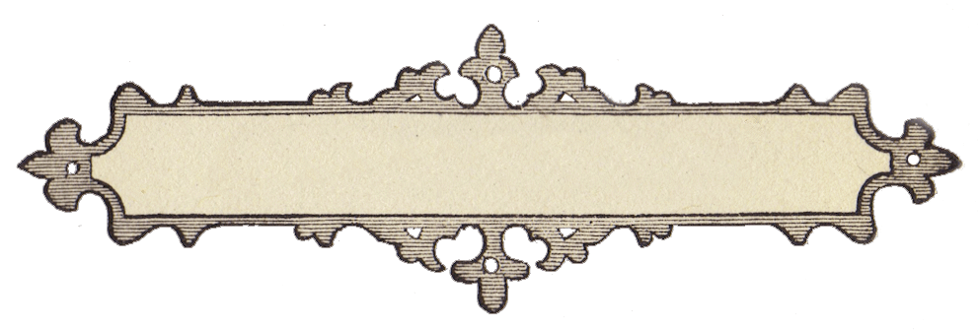
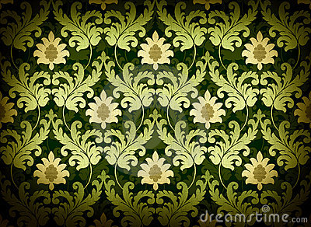
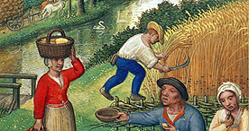
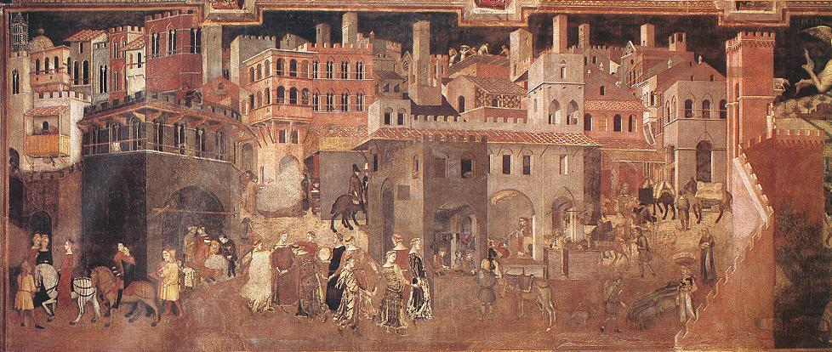
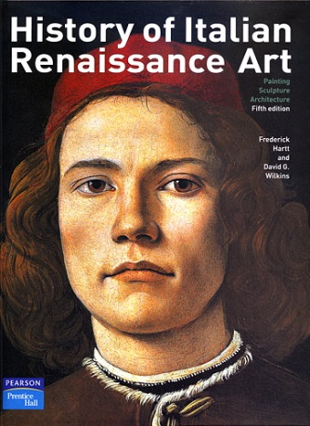
Renaissance in Italy
Renaissance means “Rebirth”
Began 1300s, peaked around 1500
Transition from medieval times to early modern world
A time of creativity,& changes in: social, economic, cultural, technology
Shift – agricultural to urban society

Slide 4
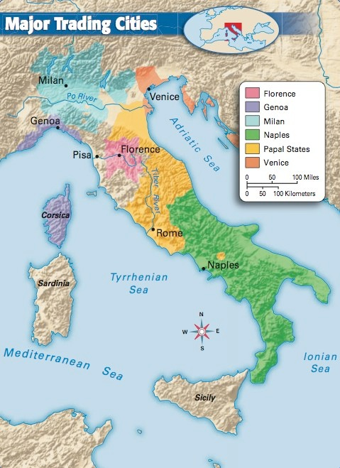
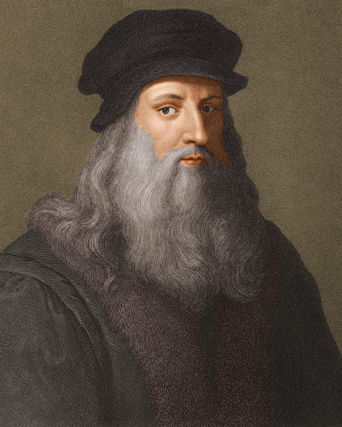
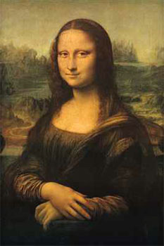
Renaissance in Italy: Ch 13, Sec 1
The Renaissance began in Italy because of:
its central location and control of trade
Wealth from trade supported artists & scholars

Slide 5
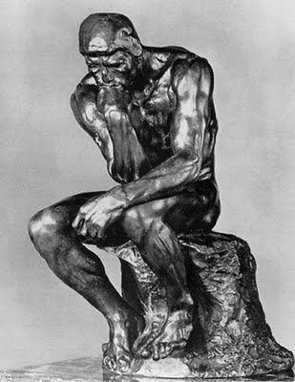
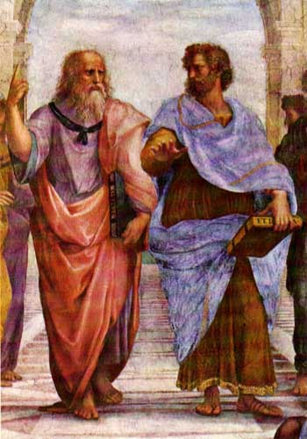
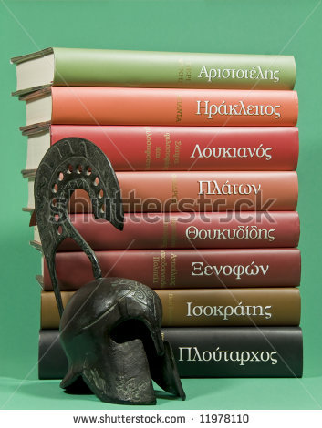
Reawakened interest in Greek & Roman classical learning
Medieval thinkers focused on religious thinking
Renaissance thinkers focused on human experience & individual achievement

Slide 6
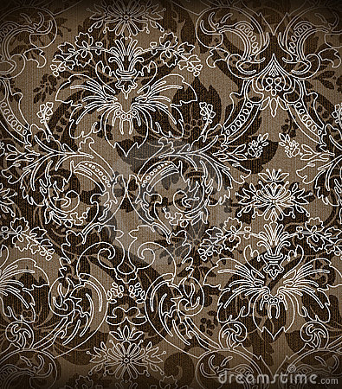
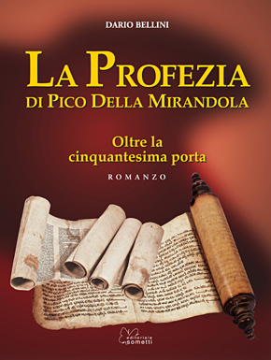
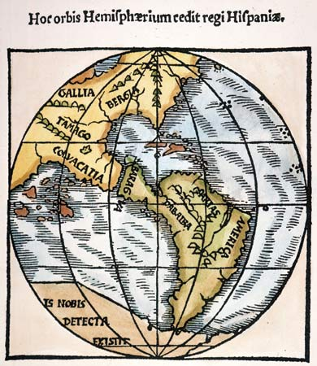
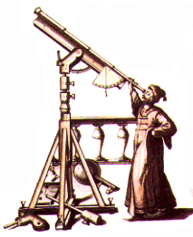
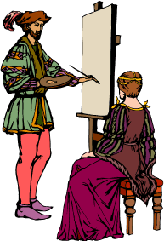
A spirit of adventure
To explore new worlds – seas & skies
Writers & artists = new forms & techniques
“To (man) it is granted to have whatever he chooses, to be whatever he wills”
Excitement expressed by Pico della Mirandola in 1486

Slide 7
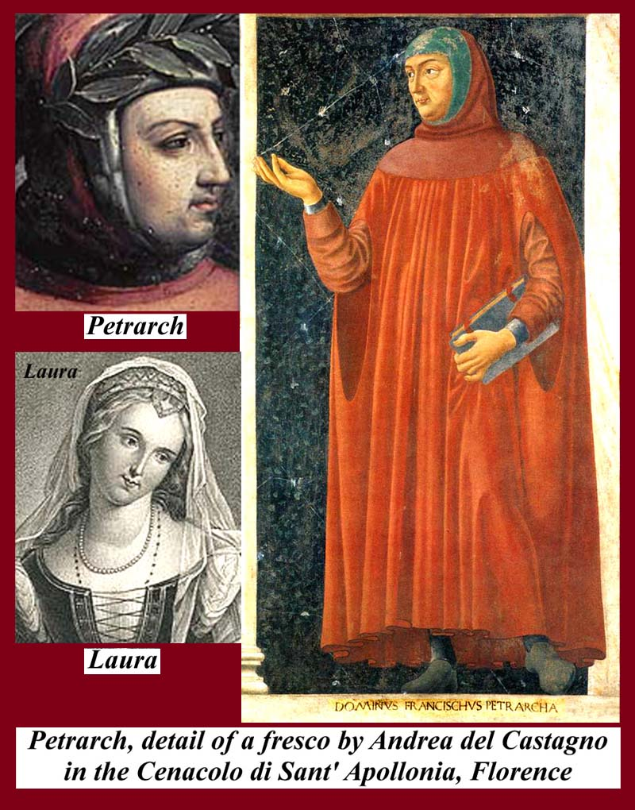
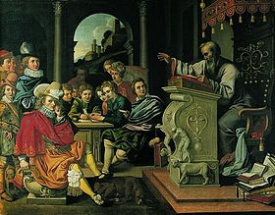
Intellectual movement –
Humanism - system of thought attaching prime importance to human rather than divine or supernatural matters.
Studied classical cultures of Greece & Rome
Most were Christians, but, focused on worldly subjects
Believe education stimulates creativity
Emphasized grammar, rhetoric (the study of using language effectively), poetry and history
Petrach – Florentine, 1300s
Early humanist, poet, scholar
Assembled library of Greek & Roman manuscripts
Considered “father of humanism”

Slide 8
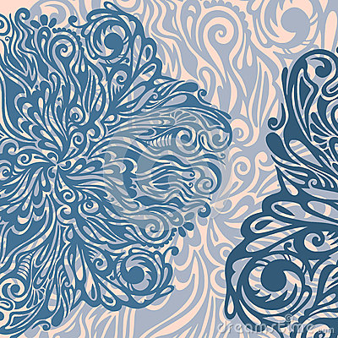
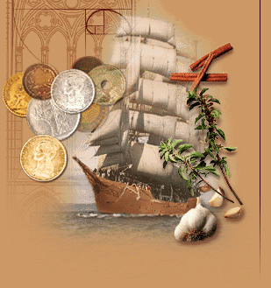
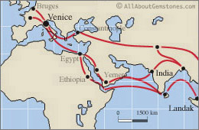
ITALY is the “Cradle of the Renaissance” --- WHY?
Italy’s location in Mediterranean Sea encouraged trade
Banking helped support trade
Provided wealth, fueling Italy’s Renaissance
Carried goods & new ideas
Muslim scholars had preserved ancient knowledge

Slide 9
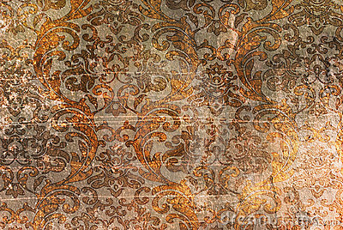
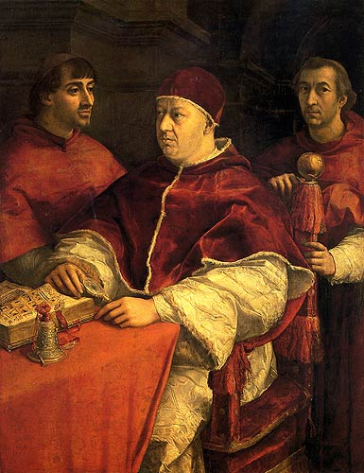
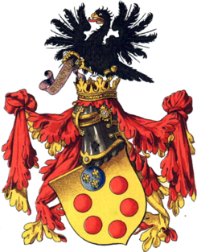
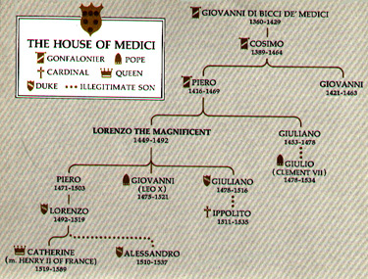
Italy – independent city-states
Each controlled by powerful family
Powerful families were always vying for power
Medici Family controlled Florence , took over in 1434– richest merchants & bankers in Europe
Generous patrons – supported many artists

Slide 10
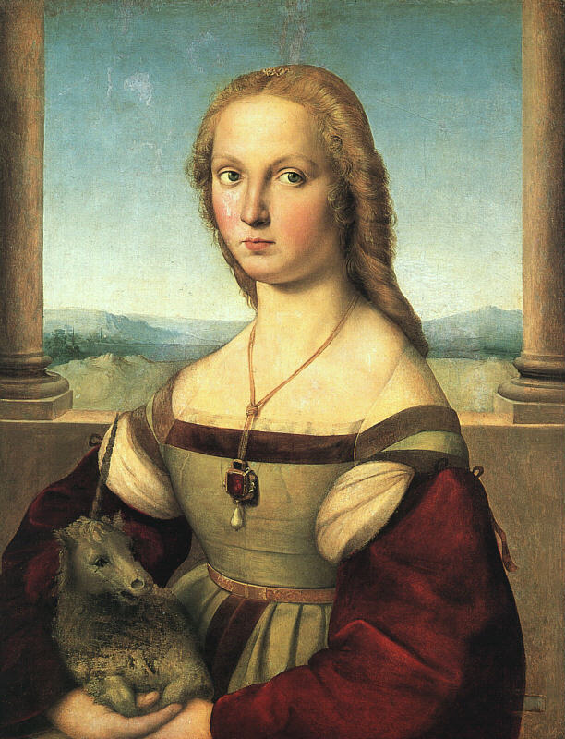
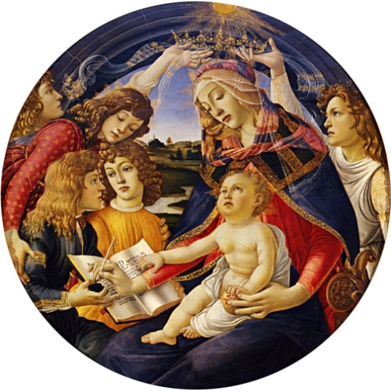
Renaissance art reflected humanism
Many were religious paintings
Greek & Roman backgrounds
Portraits of well known figures
Showed much more human emotion
Returned to classical realism
(CLASSICAL = ancient Greece and Rome)

Slide 11
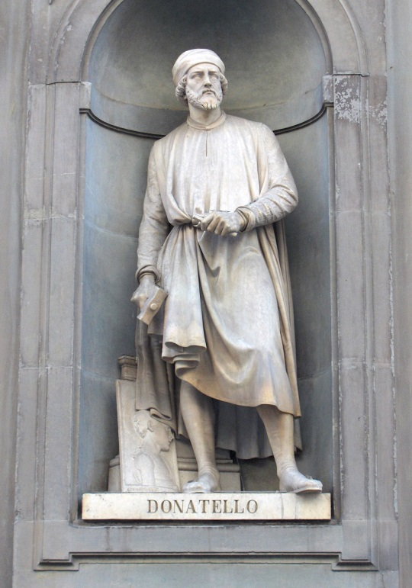
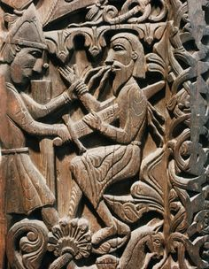
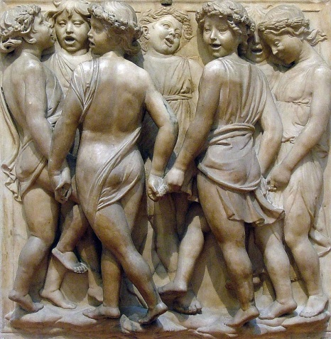
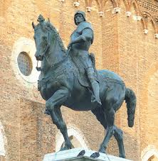
Donatello was a sculptor from Florence, Italy.
He used bas relief, which is a shallow form of sculpting.
It was realistic and created an illusion of three dimensions.
He also created life size free standing sculptures, the first to do that since ancient times in Greece and the Roman Empire.
All examples of classic realism.
This is a medieval
bas relief sculpture
This is a bas relief sculpture
This is a Renaissance
bas relief sculpture
This is a life size sculpture of a Roman soldier

Slide 12
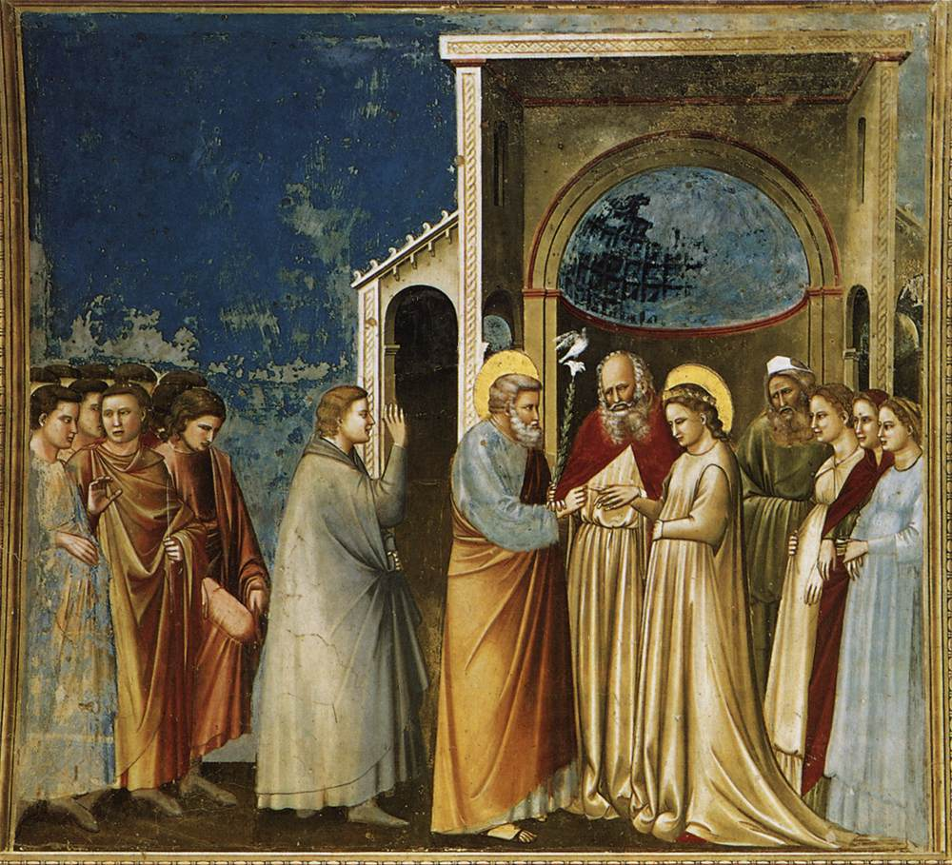
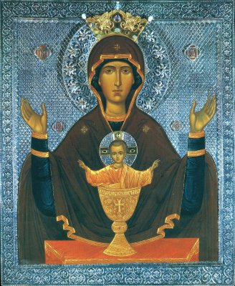
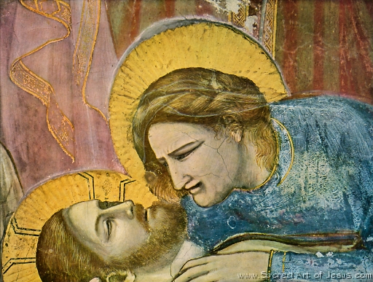
Giotto painted using human qualities & emotions
Medieval Religious Painting

Slide 13
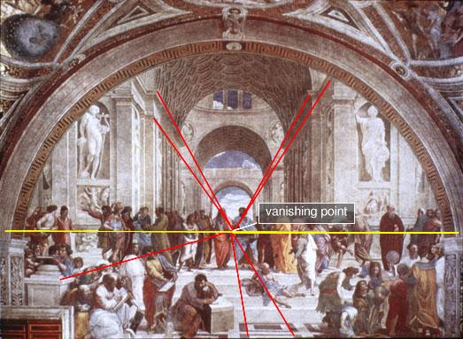
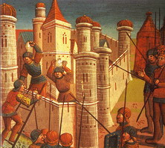
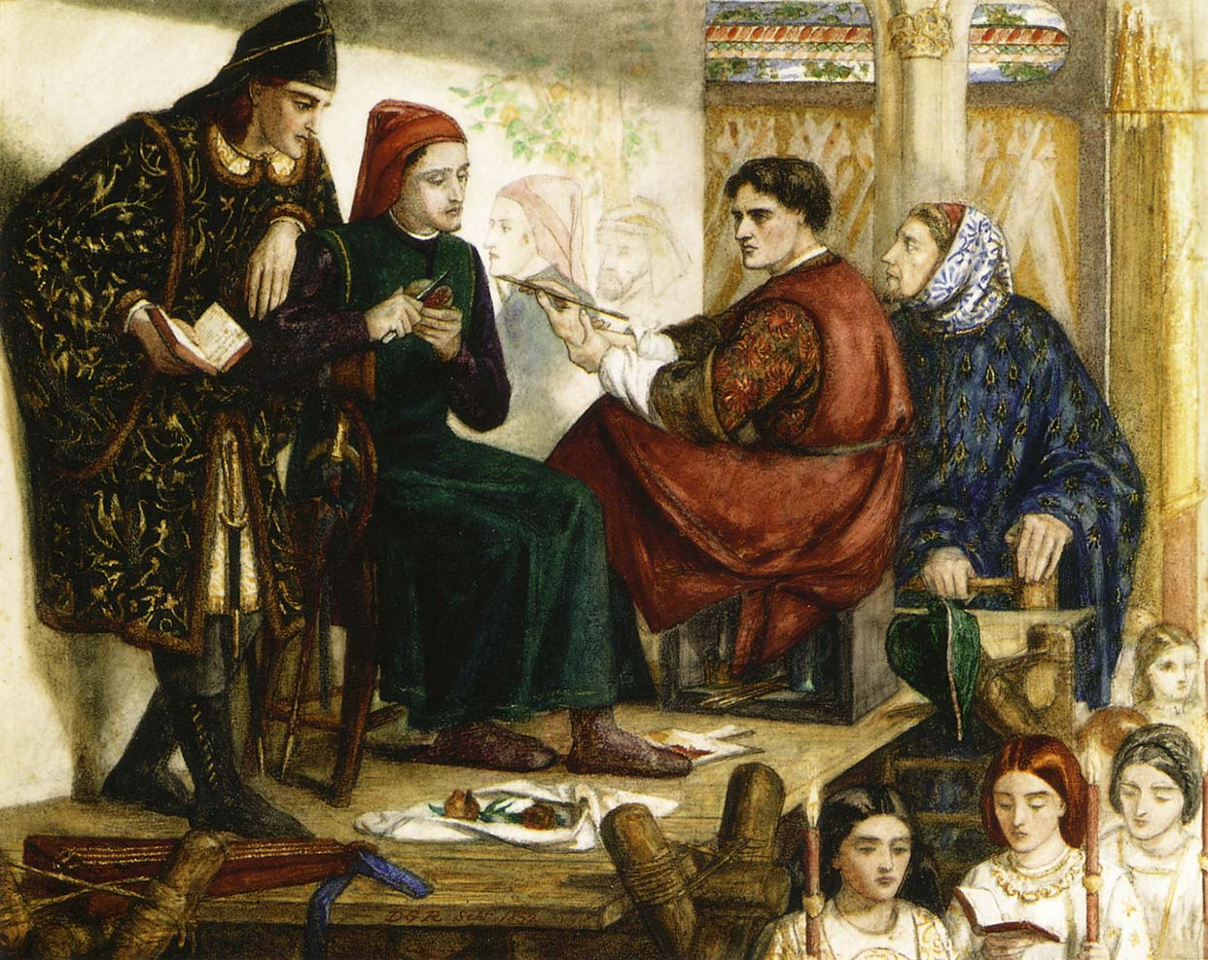
Giotto led way using perspective– 3-D effect
Use of shading, light & shadow, more realistic
Used live models to portray human body
Medieval Painting

Slide 14
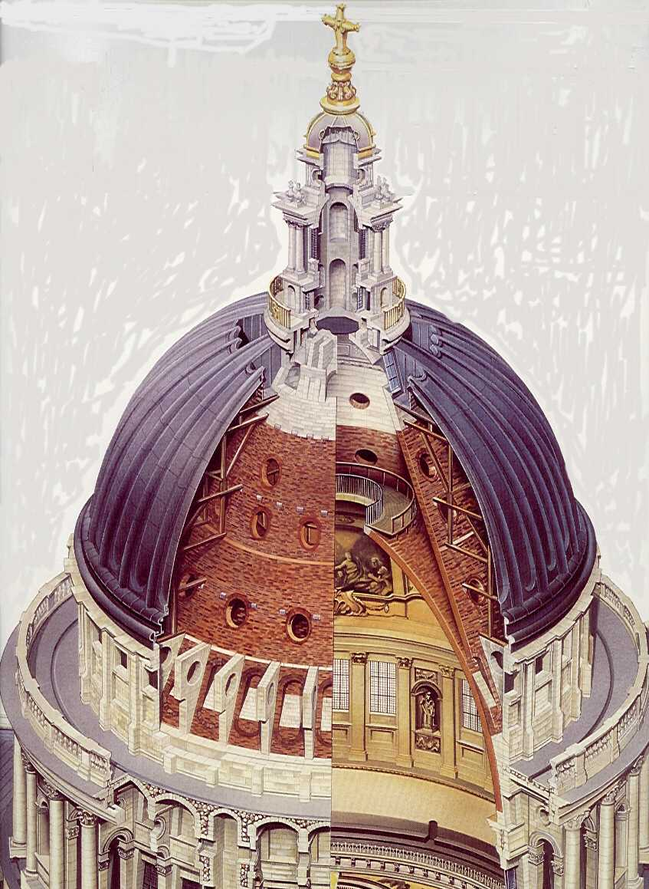
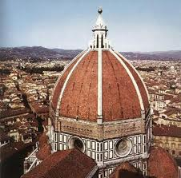
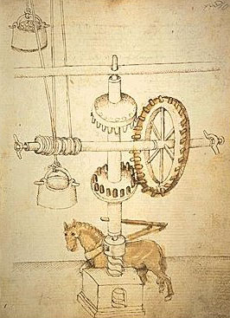
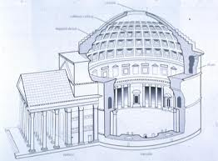
Adopted Greek & Roman columns, arches & domes
Brunelleschi copied dome of Pantheon to create cathedral in Florence
Brunelleschi multitalented: studied art, sculpture, engineering
Invented many machines to build his dome
Pantheon

Slide 15
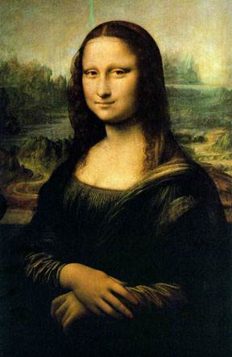
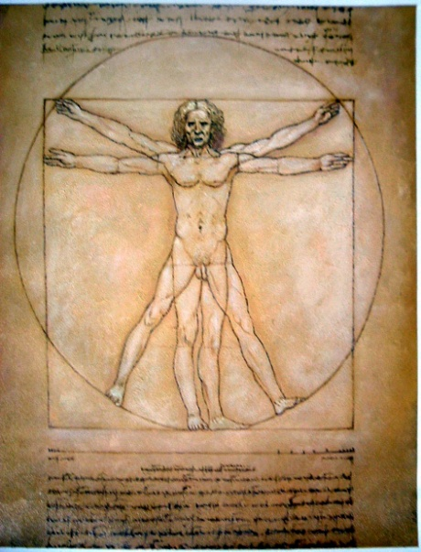
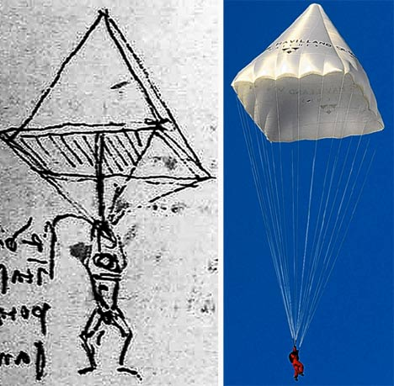
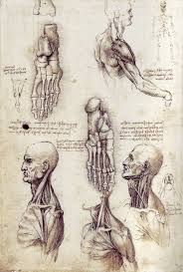
Leonardo da Vinci
Studied botany, anatomy, optics, music, architecture, engineering
Designed flying machines, parachutes, submarines & much more
1452 – 1519 A.D.
Genius of invention
Dissected corpses to learn how muscles & bones worked
Portrait, Mona Lisa – mysterious smile, still baffling – one of most recognized paintings of all time
Mona Lisa
Vitruvian Man

Slide 16
Michelangelo Buonarroti
Painted ceiling & murals of Sistine Chapel, Vatican
Designed St. Peter’s Cathedral, Vatican, Rome
1475 – 1564 A.D.
Sculptor, engineer, painter, architect, & poet
Called “melancholy genius” – reflected personal struggles
Created sculptures of David & the Pieta in his twenties
Rival of da Vinci
“Birth of Adam”, Sistine Chapel
David
Sistine Chapel ceiling
The Pieta (Jesus w/his mother Mary)
St Peter’s Cathedral

Slide 17
Raphael
A few years younger than Michelangelo (1483 – 1520 A.D.)
Admired for artistic talent & “his sweet & gracious nature”
Blended classical & Christian styles
Best know for portrayals of Madonna, mother of Jesus
Painting, “The School of Athens”, featured imaginary gathering Plato, Aristotle, & Averroes

Slide 18
Machiavelli’s, “The Prince”
A guide for rulers: how to gain & maintain power
Not by high ideals but by ruthless behavior
The end justifies the means
Do whatever it takes to achieve goal: lie, cheat, steal, etc.
Later students of government say he provided realistic look at politics
Raises important ethical issues
Hmmmm. .... Think about our presidential election …. see any of that?
Machiavellian now means – deceit in politics

Slide 19
Renaissance in the North: Ch 13, Sec 2
Printing Revolution: 1455, Johann Gutenberg, Mainz, Germany
Printed 1st complete Christian Bible using movable type: printing press
Before, had to be copied by hand-very expensive
Now, can make books much faster, less expensive
More can now read – education increases
Movable type – individual letters can be moved around

Slide 20
Flemish Painters
1600s Rubens
Painted about mythology, Bible, classical history
1400s Jan van Eyck
Painted townspeople, peasants, religious scenes
Vibrant colors
Medusa
Late 1400s Durer
Engraving design on metal plate with acid
Use plate to make prints
Portray religious upheaval

Slide 21
Erasmus:
Making Humanism Popular
Dutch priest, born 1466
Most important scholar of the age
Produced new Greek edition of Bible
Spread Renaissance humanism to wider public
Translated Bible into vernacular
Each individual should be open- minded, educated & show good will to others

Slide 22
Sir Thomas More
English humanist
Pressed for social reforms
Wrote UTOPIA, describes ideal society, everyone lives in peace & harmony
No one is idle
All are educated
Today, UTOPIAN describes any ideal society (which is ultimately impractical – doesn’t work)
“You wouldn't abandon ship in a storm just because you couldn't control the winds.” ― Thomas More, Utopia

Slide 23
Shakespeare Writes for all Time
English poet & playwright
Towering figure of Renaissance
Between 1590 & 1613 he wrote 37 plays – still performed today!
Expressed universal themes in everyday settings
Explores complexity of individual, feelings, thoughts
Everyday people can understand & appreciate
Used vernacular
Love of words enriched English language – 1,700 new words appeared in his works!!!!

